Slide 1
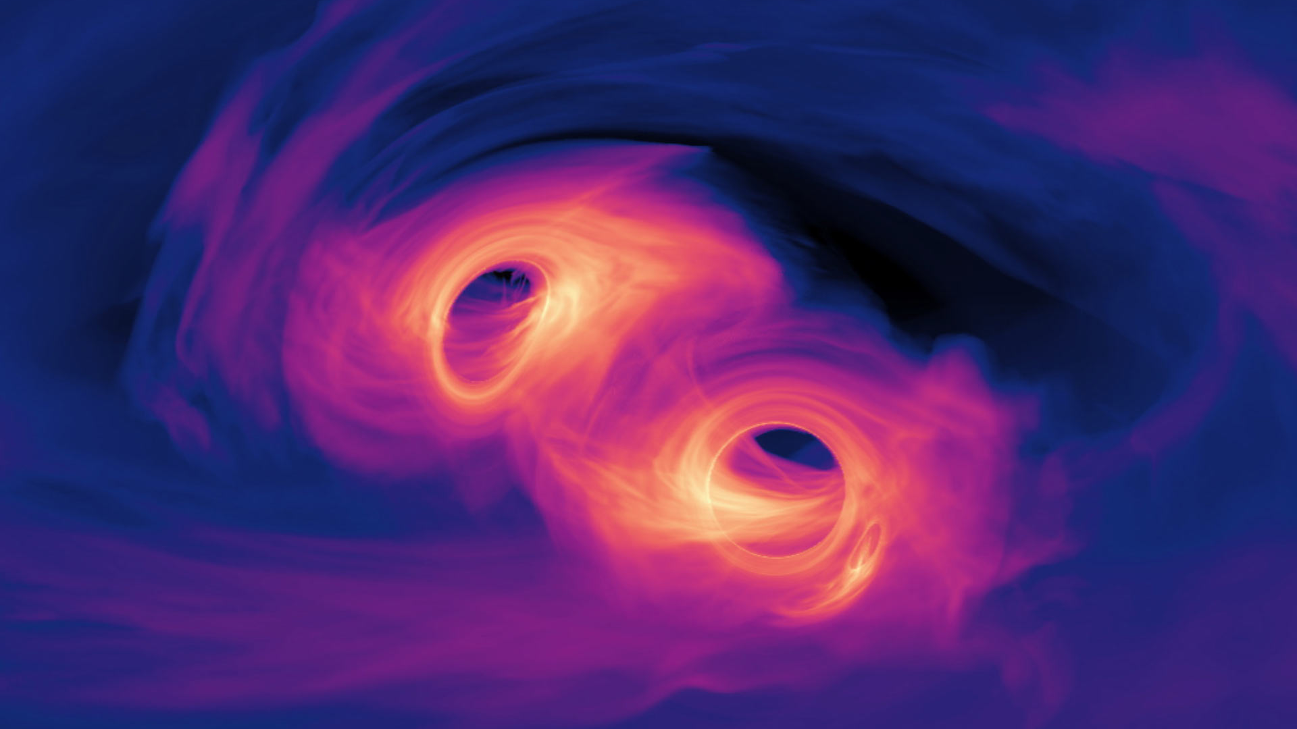
Studying the merger of two black holes
Thesis proposal, by Jordan Moncrieff
Supervisors: Bruce Gendre, Fiona Panther
Image credit: NASA’s Goddard Space Flight Center.
Notes:
Hello everyone, my names Jordan. I’m a bachelor or Philosophy honours student, studying theoretical Physics. My project is on the study of the merging of two black holes, under the supervision of Bruce Gendre, and Fiona Panther.

Slide 2
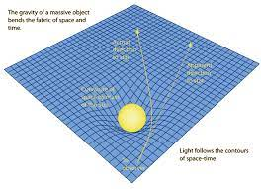
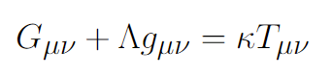
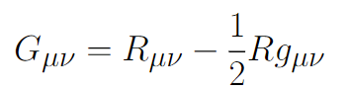

General relativity
Spacetime tells matter how to move
Matter tells spacetime how to curve
Curvature of spacetime
Dark energy
Energy source
Ricci tensor = spacetime
Metric $g_{μν}$ = gravitational field
Image credit: R Nave
Notes:
To start, I will really quickly talk about general relativity and black holes.
General relativity is governed by Einstein’s field equations, shown here. This equation says that the curvature of spacetime, which we can identify with the Einstein tensor, is related to matter and energy sources, given by the stress-energy tensor on the right. This equation just says, in the words of John Wheeler “space-time tells matter how to move, and matter tells space-time how to curve”.
So a mass like the Earth curves the space around it, and other masses within the vicinity of the Earth - like a satellite orbiting - will feel this curvature, and move in straight lines in this curved space (geodesics), which corresponds to the forces of gravity we observe in the world – as shown in this picture on the bottom right.

Slide 3
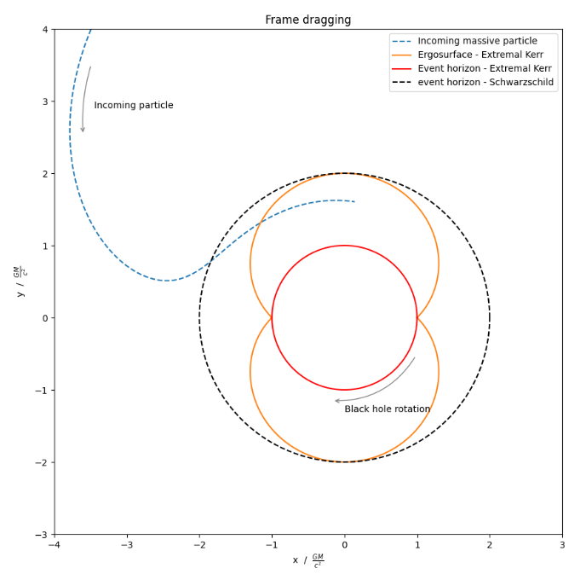
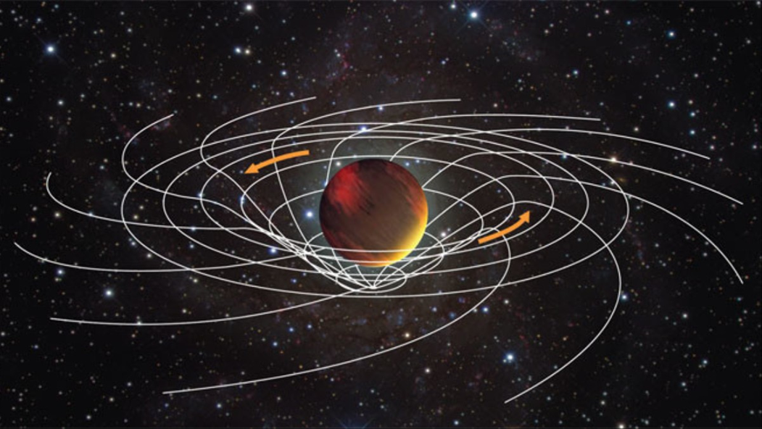
Kerr black holes and frame dragging
Notes:
One of the coolest predictions of general relativity are black holes, and of particular interest in in my project, are black holes with spin – so called “Kerr black holes”
This spin of black holes leads to a number of really interesting phenomena, for example
The event horizon (the region where the escape velocity is greater than the speed of light, meaning nothing can escape) is smaller than that of Schwarzschild black hole (a black hole with no spin)
This is because to the effective radius decreasing in size due to rotating spacetime around the black hole
Another really interesting effect is that of “frame dragging”, where spacetime literally rotates with the rotation of the black holes, dragging any particles with the black hole spin. This results in a region called the ergoregion, where all particles, no matter there original angular momentum, are forced to rotate in the direction of the spin.
You can see the effect of frame dragging in this plot on the left, where the incoming particle in blue is pulled to spin in an orbit in the opposite direction to its initial velocity. I’ll come back to frame dragging more later.

Slide 4
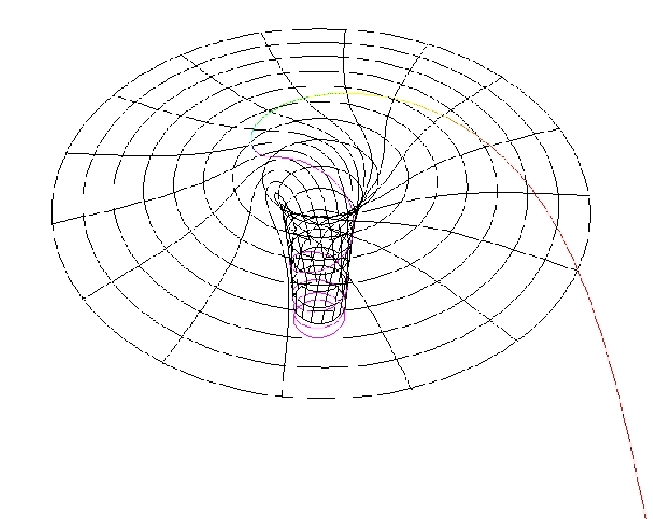
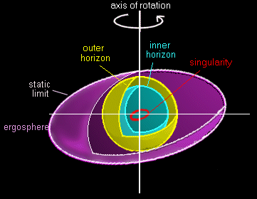
Image credit: Credit: Nico Hamus
Image credit: Credit: N. Rumiano.

Slide 5

Binary black holes
Notes:
In this project, we are interesting in two rotating black holes that orbit one another in a black hole binary.
As these black holes orbit one another they are obviously experiencing acceleration. And just like how accelerations of charged particles producing a change in the electromagnetic field that is propagated out at the speed of light in the form of electromagnetic radiation, changes in the gravitational field from accelerating masses results in the emission of gravitational radiation – called gravitational waves.
The two black holes orbiting each other lose energy from emitting gravitational waves, causing there orbits to close in on one another before finally colliding, and merging into a single spinning black hole.
This results in several solar masses of energy being lost from the system, and the emission of more energy in the form of gravitational radiation than the combined power from all the stars in the universe.
Signals from these mergers are what is detected by the interferometers at LIGO and VIRGO.
Now gravitational waves, as I mentioned are really similar to electromagnetic waves. And this is no accident, it is a hint at the connection between general relativity and electromagnetic phenomena. I’m going to be spending the rest of this presentation talking about this relationship. To flesh out this relationship, I’m going to go on a bit of a detour, and discuss a field closely tied to electromagnetism – magnetohydrogynamics and plasma physics.

Slide 6
Similarities
GR and EM comparison
Differences
Weak field limit of GR equations same form as Maxwell’s
Both propagate at speed of light
Both produce radiation
EM radiation is dipolar (net charge is conserved)
Gravitational radiation is quadrupolar (mass and momentum conserved)
No negative mass
EM force spin 1, gravity spin 2
Reconnection
Reconnection
Notes:
So there are a lot of similarities between GR and E&M, but there are also a few differences.
For example, while EM radiation is dipolar (due to conservation of charge implying there is no monopole contribution), GW radiation is quadrupolar (due to conservation of mass and (angular) momentum preventing monopole and dipole terms respectively).
Another difference is the fact that there is no negative masses, while there are positive and negative charges.
The question this project would like to answer is, where does reconnection belong in this table – is it a similarity or a difference?

Slide 7
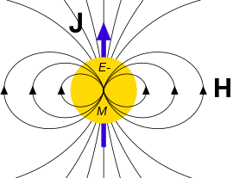
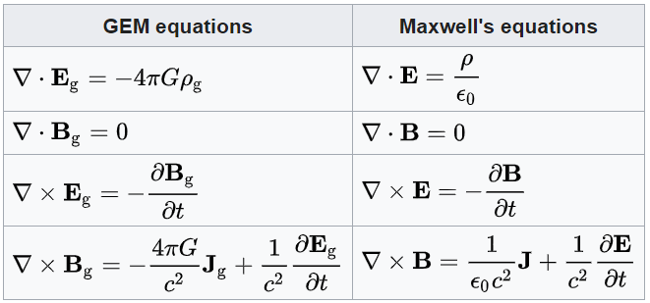
EM and GR analogy
Many strong analogies between gravity and EM.
Gravitoelectromagnetism (weak field limit of GR) produces equations very similar to Maxwell’s.
Gravitoelectric and gravitomagnetic fields appear.
Experimentally identified effects, such as spin precession and Lense-Thirring effect.
Image credit: https://en.wikipedia.org/wiki/Gravitoelectromagnetism
Notes:
Firstly, why would one expect there to be any link between Plasmas and Gravitation? To answer that, lets look at the link between electromagnetism and general relativity that I alluded to before.
The link between electromagnetism and general relativity has existed for a long time, with Einstein spending the second half of his life trying to unify the two forces.
The analogy between the two fields is seen most clearly in the weak field limit of general relativity (the limit where we assume spacetime is close to flat, with a small perturbation), this leads to Einstein’s field equations reducing to the Gravito-electro-magnetic equations, a set of PDEs that are remarkably similar to Maxwell’s equations.
This introduces two fields associated with a gravitational mass, the gravito-magnetic and gravito-electric fields.
A non spinning black hole would have just an gravito-electric field, like how any charged object produces an electric field (Newtonian charge).
A spinning black hole, due to the effect of frame dragging, will have an associated gravito-magnetic field.
To see why this is, consider a positively charged sphere rotating about its axis. This rotation will create a bunch of current loops, which will produce a dipole – acting as a magnetic field. In the same way, frame dragging will produce its own sort of dipole field, deflecting incoming massive particles (i.e. particles with “charge”) as if it was a magnetic Lorentz force. But this is just what frame dragging is! A result of the fabric of spacetime rotating.
These effects have been shown experientially, producing the so called Lense-Thirring effect. This causes the spins of binary black holes to precess as they approach each other, similar to how the spin of an electron precesses in an external magnetic field (Larmor precession).

Slide 8
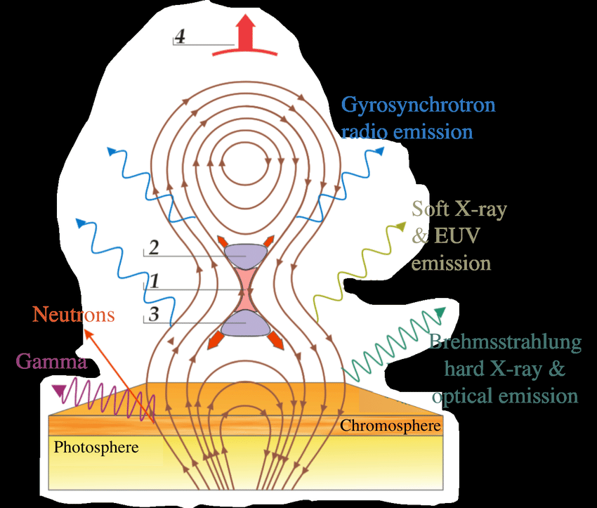
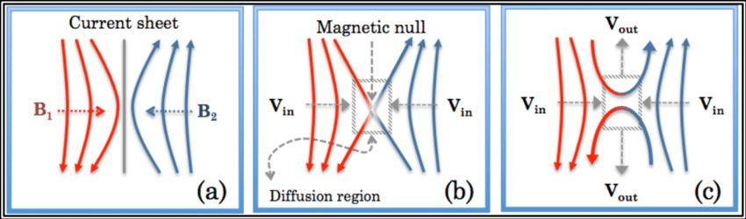
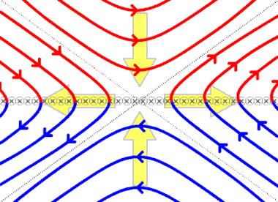
Magnetic reconnection
Magnetic field lines in plasma can snap, and reform into a new arrangement, releasing large amounts of magnetic energy in the form of particle and EM emission.
Happens in current sheets, where magnetic field can go to zero due to resistivity, allowing field lines to be “cut and pasted” back together.
Occurs frequently in space, e.g. with solar flares in the sun.
Credit: Kevin J. Genestreti
Credit: https://en.wikipedia.org/wiki/Magnetic_reconnection
Credit: Allison Youngblood
Notes:
**Maybe rewrite this part for new diagrams – make briefer**
The last effect in Plasmas that I want to talk about is that of magnetic reconnection, where magnetic field lines break and reform in a different arrangement, producing energy in the process. To see how it works, consider the following situation where magnetic reconnection occurs:
Magnetic field line rapidly decreasing down from the top of page (moving right), until it flips direction and begins increasing in magnitude down the page (blue region).
In center there is zero magnetic field, and due Amperes law there is a current sheet moving into the page. Due to magnetic pressure, pressure much higher outside current sheet then within, resulting in a force sucking the plasma towards the central current sheet along with the frozen in magnetic field lines.
As the frozen in field line reaches near the current sheet, ideal MHD breaks down (resistivity becomes finite) and the diffusion term in the ideal induction equation becomes relevant. This results in both the upper and lower magnetic fields decaying in the horizontal direction (possibly just ohms law?)
Zero horizontal magnetic field means the diagonal components of each magnetic field can join up (cut and pasting of field lines), and magnetic tension will then pull the resulting joined field lines across the current sheet.
The plasma moves with this frozen in magnetic field out from the centre, resulting in a drop in pressure, dragging more of the field lines towards the centre, completing the process
This process is shown here in this animation, magnetic field lines are sucked into the current sheets, the horizontal components or the magnetic fields drop to zero from resistivity effects, and this allows the vertical components of the magnetic fields to smoothly join together, at which point magnetic tension drags these fields outwards off into space.
Magnetic reconnection shows up all over the place in Astrophysics. The most famous example is probably in Solar flares, shown in this next image. At sunspots, locations in the sun with intense magnetic fields (resulting in a lower temperature from cooler regions deeper in the sun, resulting in the visible dark patches on surface of sun) coming out of the photosphere can reconnect with itself and releasing its magnetic energy in the form of emission of charged particles and EM radiation. (Think of magnetic energy release like the snap when a twisted rubber band snaps).

Slide 9

Question
Can an effect like magnetic reconnection occur in gravity?
Gravitational reconnection?
Notes:
The question I would like to address in my thesis is:
Can an effect like magnetic reconnection occur in general relativity, where gravitational field lines reconnect?
And if so, could this “gravitational reconnection” have Astrophysical consequences?

Slide 10
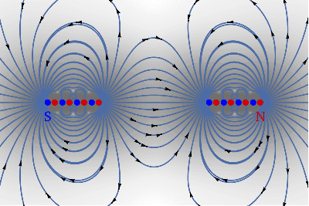
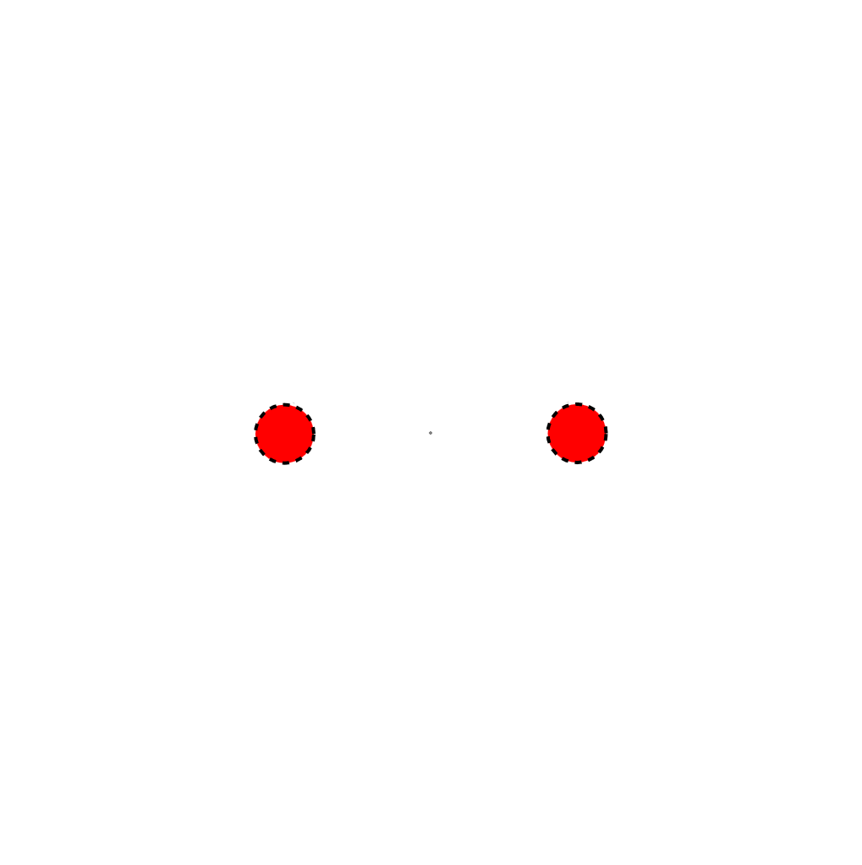
Gravitational reconnection
Can observe magnetic field lines snapping at null points as two bar magnets approach.
Could analogous effect occur with orbiting pair of binary Kerr black holes (gravitational analogue of a dipole).
Reconnection at null points between black holes could cause an ejection of material.
Demonstration of reconnection between dipoles, taken from stack exchange post: https://physics.stackexchange.com/questions/559741/what-is-happening-when-magnetic-field-lines-snap-or-break
Cartoon illustrating how reconnection of gravitational field lines might look between binary (Kerr) black holes
Notes:
To see how gravitational reconnection could occur, lets view a simple case of reconnection that occurs in electromagnetism.
This animation at the top shows essentially two bar magnets (modelled as a chain of dipoles) oriented in opposite directions approaching one another.
Notice that a null spots (indicated by green dots) appear on either side of the magnets, with these points of zero field approaching the centre as the magnets come together.
At these null points, since there is zero magnetic field, the magnetic field lines that previously belonged to a single bar magnet “snaps” and reforms into a field line connecting the two separate bar magnets.
A particle trapped that travels to a null spot will momentarily be free of the field, and could then potentially escape the system under the right circumstances.
Consider now a pair of binary black holes. Classically, we know there is a null spot in the gravitational field at the centre of mass of the binary system, and the combined frame dragging from each of the black holes could produce null spots and different locations. At this gravitational field null point, the field is able to snap and reconnect to change its topology.
The question is, could any material that was originally within this null point then be ejected by the system? Potentially forming some sort of jet travelling perpendicular to the orbital plane, maybe like the cartoon shown on the bottom right (like a coronal mass ejection, but for black holes).
The bottom right image is a bad animation I made illustrating the kind of process that could occur. Two Kerr black holes approaching orbiting each other act like dipoles due to frame dragging, and when these gravitational dipoles interact, like with the magnetic dipoles, the gravitational field lines reconnect. And this could result in restructuring of the gravitational field lines, potentially casing some kind of ejection of material from the Lagrange points between the two masses.

Slide 11
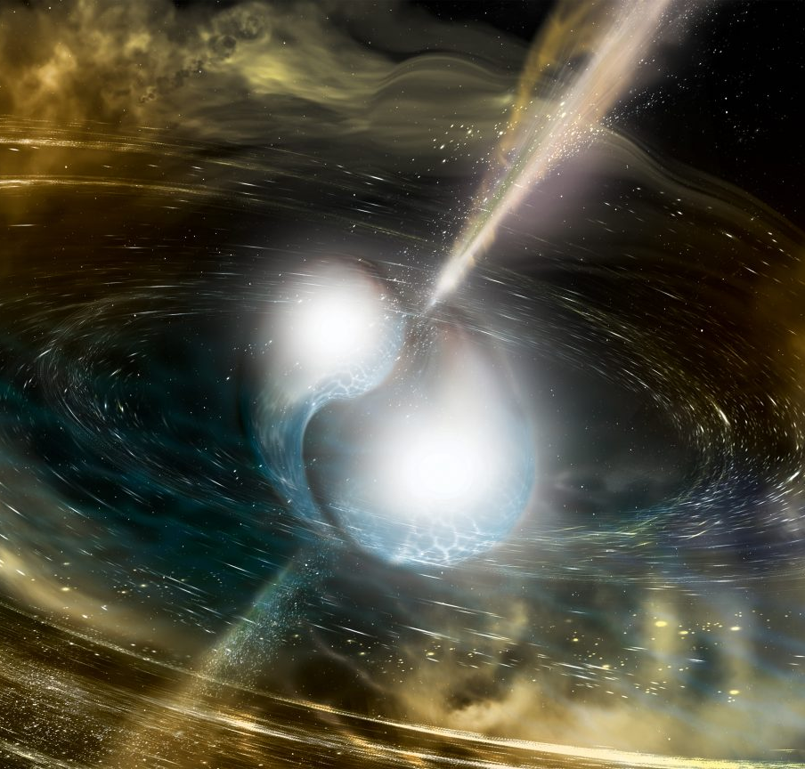
Implications
Electromagnetic counterpart to binary black hole mergers.
Possibly identify unknown signals.

Slide 12
Methods and plan
TODO

Slide 13
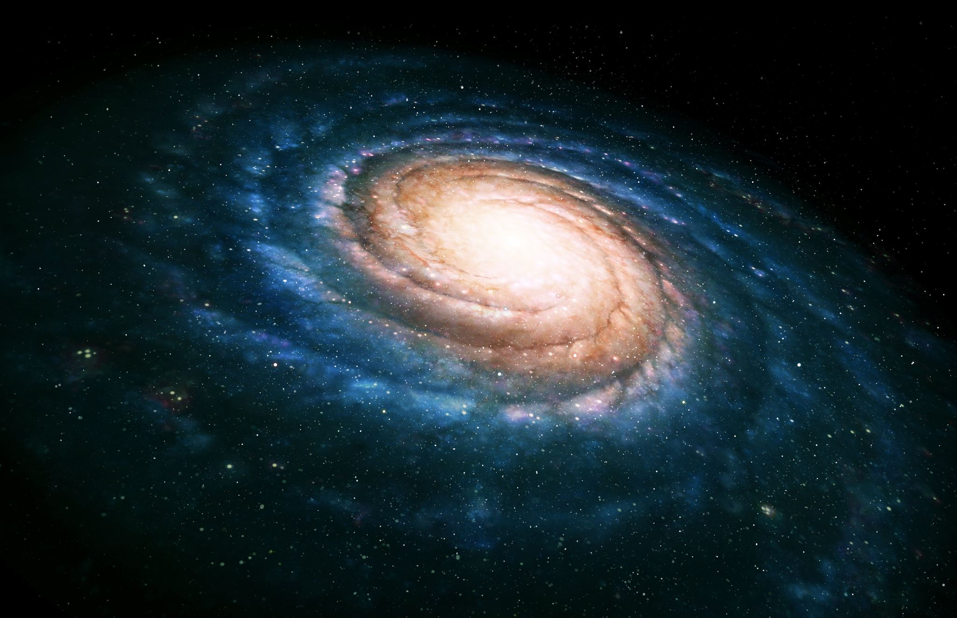
Summary
Can we extend the analogy of GR with EM to Plasma phenomena?
Could gravitational reconnection or Alfven waves occur?
If so, what would the astrophysical consequences be?
Notes:
So to summarise, this thesis hopes to extend the analogy of general relativity and electromagnetism to include a few Plasma phenomena, such as Alfven waves and magnetic reconnection.
And this could lead to new Astrophysical effects, such as possible emission of matter stuck between binary black hole pairs.
And that’s it, thank you for your time.

Slide 14
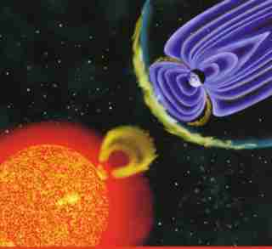
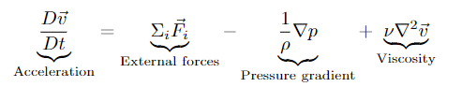
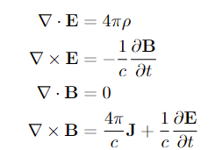
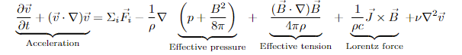
Detour to MHD and plasmas
Navier Stokes
Maxwell
MHD
Image credit: NASA
Notes:
All you need to know about MHD is that it combines the Navier Stokes equations – which describe fluid flow – with Maxwells equations (describing electromagnetism)
These equations predict the behaviour of fluids in the presence of electric and magnetic fields – which does a good job describing Plasmas, the soup of ionized atoms and electrons swirling around at high temperatures in the Sun, ISM, etc.

Slide 15
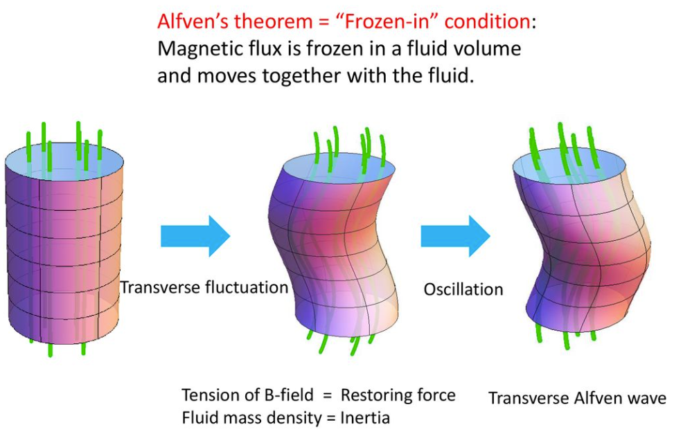
Alfvén's theorem/flux freezing
Magnetic field lines are “frozen in” the plasma, such that magnetic field lines cannot move without the plasma.
Consequence of Lenz law.
Breaks down when resistance becomes non-negligible (or plasma becomes non-relativistic).
Image credit: Koichi Hattori
https://slideplayer.com/slide/15745003/
Notes:
One of the most important concepts in Plasma Physics is Alfvens theorem, or flux freezing.
Which states that, In ideal plasma (perfect conductivity) magnetic field lines are frozen in” the plasma, such that magnetic field lines cannot move without the plasma and the plasma can not move without dragging the field lines with it.
Alfven’s theorem can be seen as a consequence of Lenz law. If the magnetic field lines were to move, the ions within the plasma would experience a changing magnetic flux, and hence would experience force to oppose the changing flux, hence moving the ion with the magnetic field lines. And vice versa, if the charges within the plasma moved, the magnetic fields would move with them
I should note, since it is important later, Alfvens theorem is an idealisation that breaks down when the plasma has non-negligible resistance (in so called “diffusion regions” or “current sheets”).

Slide 16
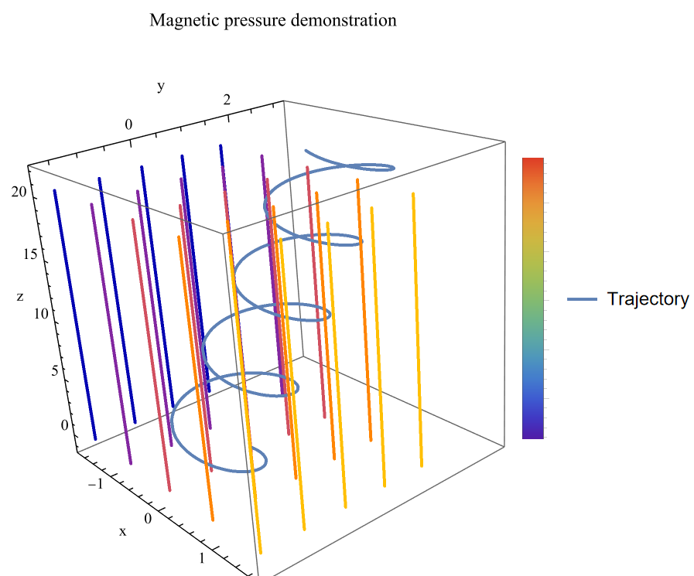
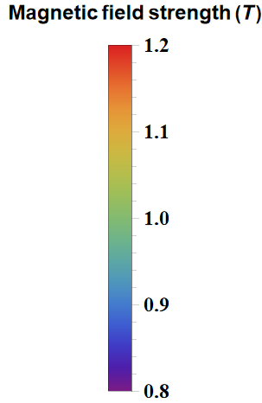
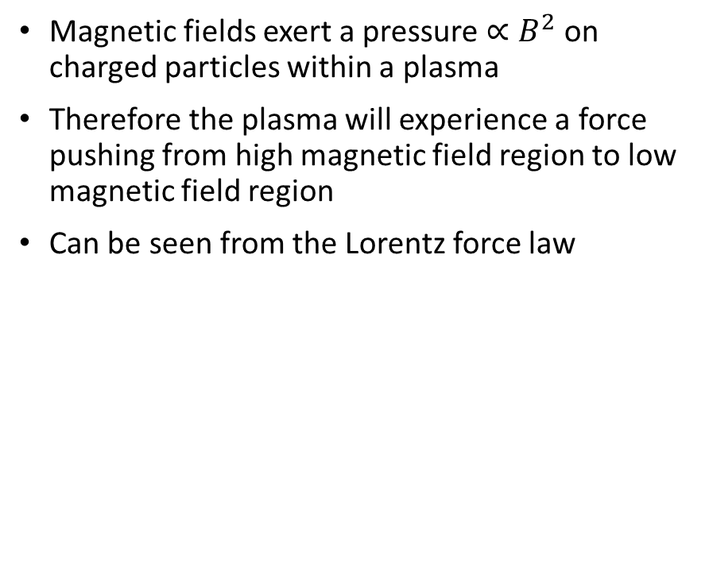
Magnetic pressure
Magnetic fields exert a pressure $∝B^{2}$ on charged particles within a plasma
Therefore the plasma will experience a force pushing from high magnetic field region to low magnetic field region
Can be seen from the Lorentz force law
Simulation of charged particle in presence of magnetic field aligned with the z-axis, with magnetic field strength increasing linearly in the x-direction
Notes:
Magnetic fields exert a pressure $∝B^{2}$ on charged particles within a plasma
This means plasma will experience a force pushing from high magnetic field region to low magnetic field region
To see where this comes from, imagine charged particles in plasma moving along a magnetic field line, in helical motion. If the magnetic field strength is weaker to one side, as the ion spirals towards the lower magnetic field, the Lorentz force back towards the higher B field will be weaker than before, hence the particle will experience a force toward the region with a lower magnetic field – acting exactly like a pressure gradient in a fluid.

Slide 17
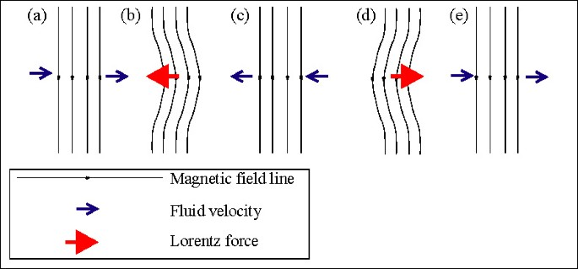
Plasmas and Alfven waves
Due to magnetic tension, perturbation to magnetic field in plasma will result in restoring force.
This restoring force will result in an oscillation in magnetic field, as well as the Plasma it is frozen in.
These disturbances will then travel out in waves, know as Alfven waves.
Credit: Encyclopedia of Geomagnetism and Paleomagnetism
Notes:
These frozen in magnetic field lines produces lots of interesting properties within Plasmas, such as a new type of wave called a Aflven wave
Alfven waves are a result of something called magnetic tension, a force exerted on bent magnetic field lines resulting in the field lines straightening out
If there's is a perturbation in the magnetic field within a plasma, magnetic tension produces a restoring force opposing this perturbation.
This causes a disturbance in the plasma the magnetic field is frozen in, and an oscillation in the plasma occurs – produces a disturbance that travels out as a wave
These waves are called Afven waves, and produce several important effects such as the heating of solar corona, or the acceleration of stellar wind.

Slide 18
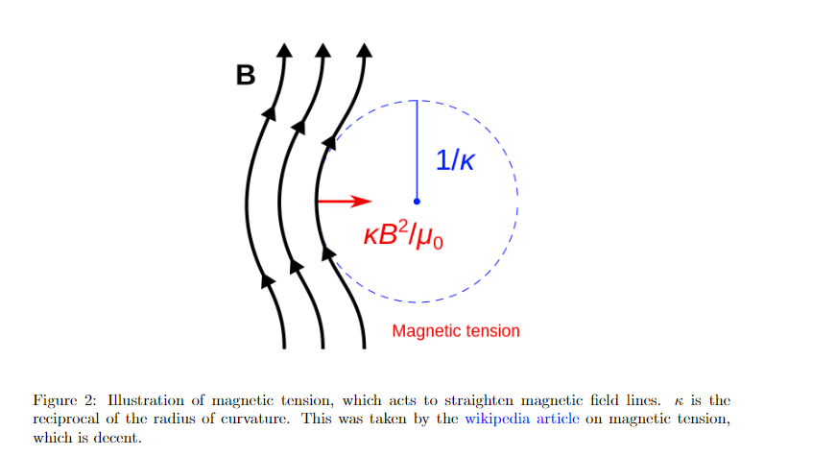
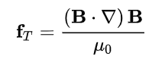
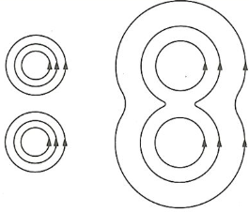
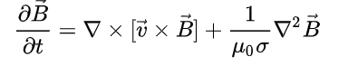
Magnetic tension
Magnetic tension is a restoring force that acts to oppose curvature in magnetic field lines.
Magnetic diffusion
In non-ideal MHD, finite resistance means magnetic field can diffuse, losing strength.
Magnetic field lines diffuse from high density to low density

Slide 19
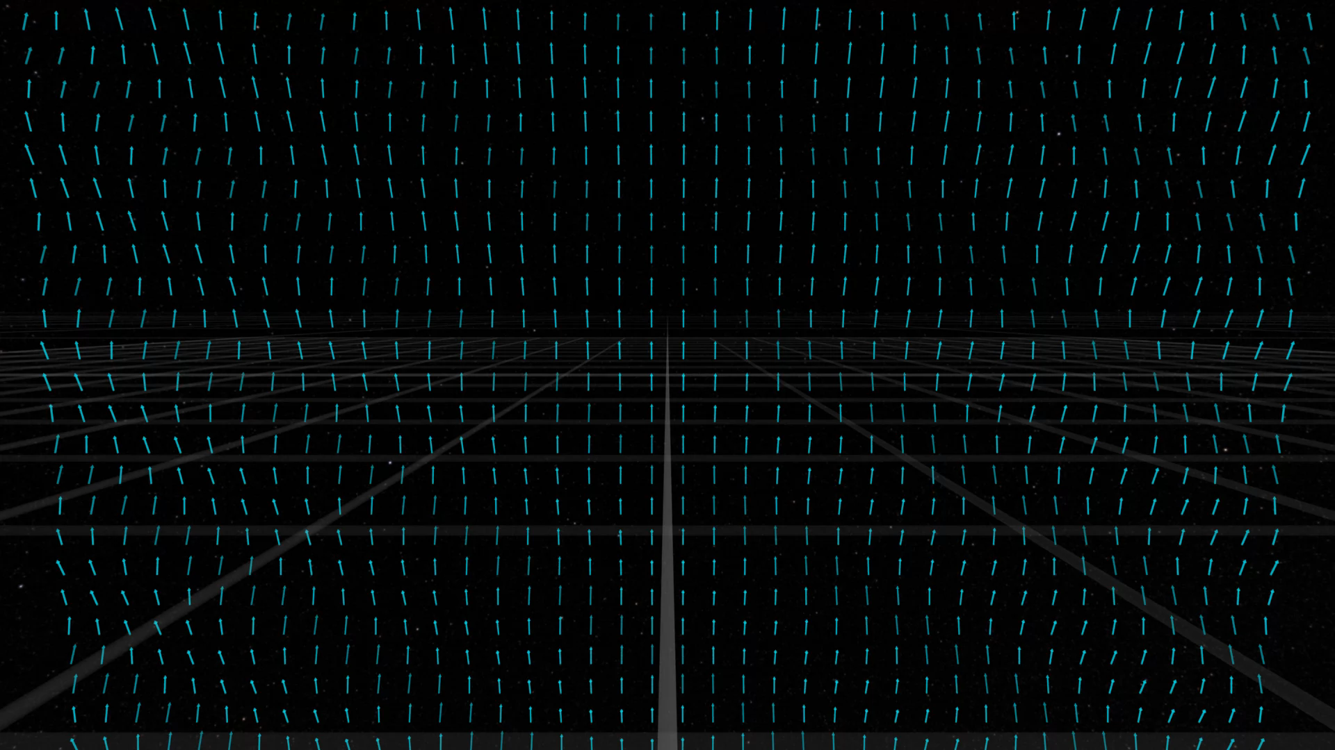
Gravitational Alfven waves?
Think of the gravitational field (metric tensor, analogous to magnetic field) frozen into spacetime (Ricci tensor, analogous to the Plasma medium).
Then what happens when there is a perturbation in the gravitational field?
Could gravitational Alfven waves occur?
Are these just gravitational waves, or something different like tidal waves (from galaxy collisions).
Implications in accretion disks.
Notes:
To extend the analogy between Plasmas further, we could think about how GR could produce an effect similar to Alfven waves.
To begin, think about the gravitational field (represented by the metric) which is frozen into spacetime (represented by the Ricci tensor) which in our analogy is the plasma medium.
Could a perturbation to the metric, result in a type of wave forming in spacetime? A sort of gravitational Alfven wave perhaps?
This could just be vanilla gravitational waves, but it could potentially be new phenomena, similar to tidal waves observed in galaxy collisions.
If these waves do occur, they could have applications to astrophysics

